Slide 1
CSC2251
Computer Programming & Applications I
(Binary Tree)

Slide 2
Binary Trees
A binary tree T is defined as a finite set of elements, called nodes, such that:
    T is empty (called the null tree or empty tree), or
    T contains a distinguished node R, called the root of T, and the remaining nodes of T form an ordered pair of disjoint binary trees T1 and T2.
If T does contain a root R, then the two trees T 1 and T2 are called, respectively, the left and right subtrees of R.
If T1 is nonempty, then its root is called the left successor of R.

Slide 3
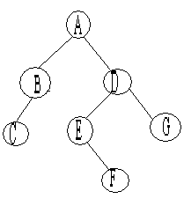
Binary Trees
T consists of 7 nodes, represented by the letter A through G.
The root of T is the node A at the top of the diagram.
A left-downward slanted line from a node N indicates a left successor of N.
B is a left successor and D is a right successor of the node A.
The left subtree of the root A consists of the nodes B and C,
and the right subtree of A consists of the nodes D, E, F, and G.

Slide 4
Binary Trees
Any node N in a binary tree T has either 0,1 or 2 successors.
The nodes with no successors are called terminal nodes.
Two binary trees are said to be similar if they have the same structure of the same shape.
Two or more binary trees are said to be copies if they are similar and if they have the same contents at corresponding nodes.

Slide 5
Expression Tree
Consider any algebraic expression E involving only binary operations, such as
E = (a-b)/((c*d)+e)
E can be represented by means of the binary tree T.
Each operator in E appears as an "internal" node in T whose left and right subtrees correspond to the operands of the operation. For example:
    In the expression E, the operands of + are c*d and e.
    In the tree T, the subtrees of the node + correspond to the sub expression c*d and e.
Every algebraic expression will correspond to a unique tree, and vice versa.

Slide 6
Terminology
Suppose N is a node in T with left successor S1 and the right successor S2.
Then N is called the parent (or father) of S1 and S2. S1 is called the left child (or son) of N, and S2 is called the right child (or son) of N.
S1 and S2 are said to be siblings (or brothers).
Every node N in a binary tree T, except the root, has a unique parent, called the predecessor of N.
A node L is called a descendant of a node N (and N is called an ancestor of L).

Slide 7
Terminology
The line drawn from a node N of T to a successor is called an edge, and a sequence of consecutive edges is called a path.
A terminal node is called a leaf, and a path ending in a leaf is called a branch.
Each node in a binary tree T is assigned a level number, as follows. The root R of the tree T is assigned the level number 0.
And every other node is assigned a level number which is one more than the level number of its parent.

Slide 8
Terminology
Those nodes with the same level number are said to belong to the same generation.
The depth(or height) of a tree T is the maximum number of nodes in a branch of T.
This turns out to be 1 more than the largest level number of T.

Slide 9
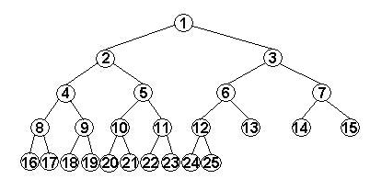
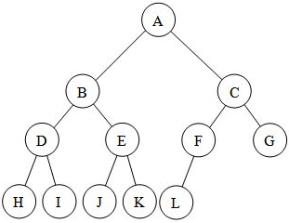
Complete Binary Trees
The tree T is said to be complete if all its levels, except possibly the last, is completely filled, and all nodes are as far left as possible.
The left and right child of node K are 2*K and 2*K+1, and the parent K is the node K/2. The depth D_{n} of the tree T_{n} is D_{n}= log₂+1.

Slide 10
Extended Binary Trees: 2-Trees
A binary tree T is said to be a 2-tree or an extended binary tree if each node N has either 0 or 2 children.
the nodes with 2 children are called internal nodes, and the nodes with 0 children are called external nodes.
An important example of a 2-tree is the tree T corresponding to any algebraic expression E which uses only binary operations.
The variables will appear as the external nodes, and the operations will appear as internal nodes.

Slide 11
REPRESENTING BINARY TREES IN MEMORY
Let T be a binary tree. The two ways of representing T in memory are:
  Linked representation of T.
  Sequential representation of T.
The main requirement of any representation of T is that one should have direct access to the root R of T and, given any node N of T, one should have direct access to the children of N.

Slide 12
Linked Representation of Binary Trees
Each node N of T will correspond to a location K such that:
    INFO[K] contains the data at the node N.
    LEFT[K] contains the location of the left child of node N.
    RIGHT[K] contains the location of the right child of node N.
ROOT will contain the location of the root R of T.
If any subtree is empty, then the corresponding pointer will contain the null value.
if the tree T itself is empty, then ROOT will contain the null value.

Slide 13
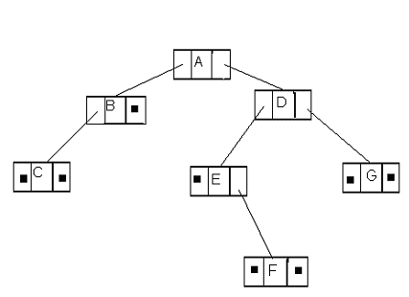
Linked Representation of Binary Trees
INFO may actually be a linear array of records or a collection of parallel arrays.
We will usually let the LEFT contain the pointers for the AVAIL list.

Slide 14
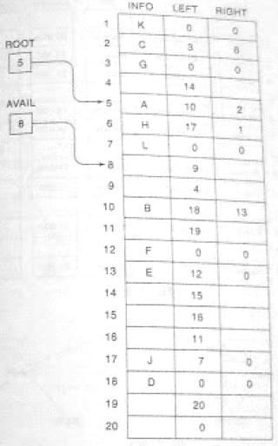
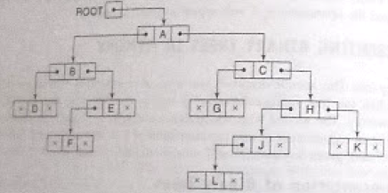
Linked Representation of Binary Trees

Slide 15
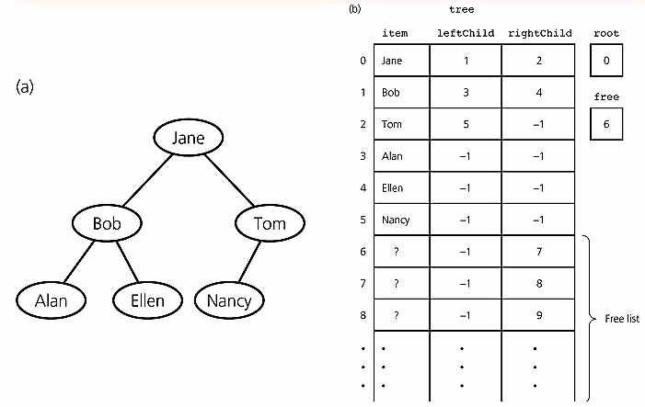
Linked Representation of Binary Trees

Slide 16
Sequential Representation of Binary Trees
This is an efficient way of maintaining T in memory.
This representation uses only a single linear array TREE as follows:
    The root R of T is stored in TREE[1].
    If a node N occupies TREE[K] then its left child is stored in TREE[2*K] and its right child is stored in TREE[2*K+1].
NULL is used to indicate an empty subtree
The sequential representation of a tree with depth d will require an array with approximately 2^{d+1} elements. (Inefficient)

Slide 17
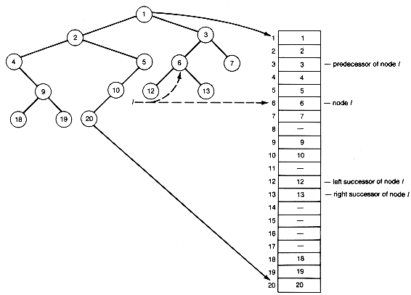
Sequential Representation of Binary Trees

Slide 18
TRAVERSING BINARY TREES
Preorder: (NLR)
    Proces the root R
    Traverse the left subtree of R in preorder.
    Traverse the right subtree of R in preorder.
Inorder: (LNR)
    Traverse the left subtree of R in inorder.
    Process the root R.
    Traverse the right subtree of R in inorder.
Postorder: (LRN)
    Traverse the left subtree of R in postorder.
    Traverse the right subtree of R in postorder.
    Process the root R.

Slide 19
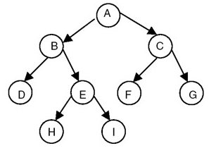
TRAVERSING BINARY TREES
Preorder: ABDEHICFG
Inorder: DBHEIAFCG
Postorder: DHIEBFGCA

Slide 20
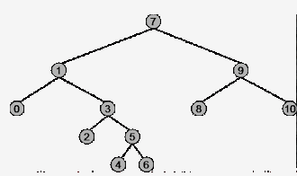
TRAVERSING BINARY TREES

Slide 21
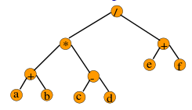
TRAVERSING BINARY TREES

Slide 22
TRAVERSING BINARY TREES
1. Let E denote the following algebraic expression:
    [a+(b-c)]*[(d-e)/(f+g-h)]
  Draw the tree T which corresponds to E.
  Find the Preorder, Inorder and Postorder traversal of T.
2. A binary tree T has 9 nodes. The inorder and preorder traversals of T yield the following sequences of nodes:
Inorder: EACKFHDBG
Preorder: FAEKCDHGB
Draw the tree T.

Slide 23
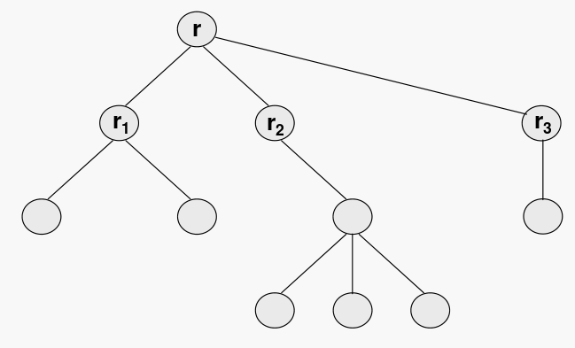
General Trees
A general tree T is a finite set of one or more nodes such that there is one designated node r, called the root of T.
The remaining nodes are partitioned into n ≥0 disjoint subsets T₁, T₂, ..., T_{n}, each of which is a tree, and whose roots r₁, r₂, ..., r_{n}, respectively, are children of r.

Slide 24
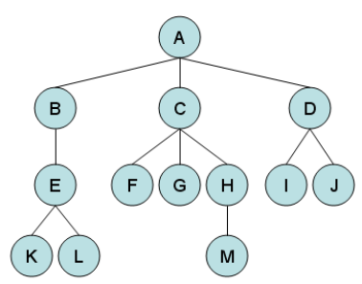
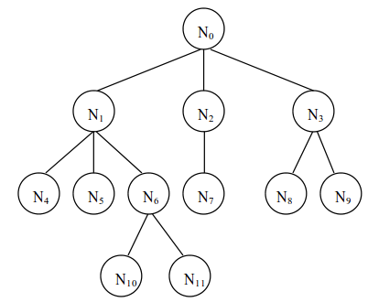
General Trees
A forest F is an ordered collection of zero or more distinct trees.
A
B

Slide 25
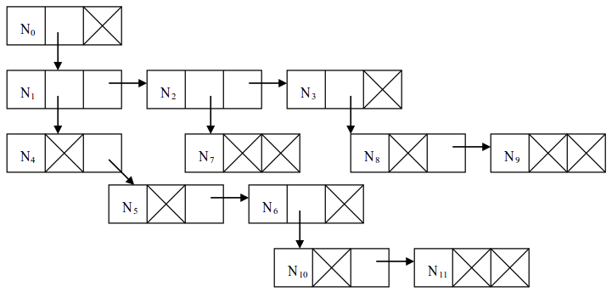
Representation of General Tree
We could use linked-lists to store the children for each node, but there is a better way that stores two pointers for each node that is called the first-child, next-sibling representation.
Using this representation, our previous tree would look like:

Slide 26
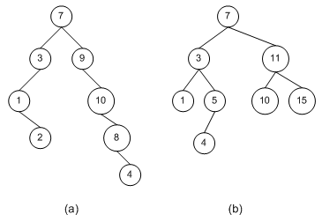
Binary Search Tree
In BST the value at N is greater than every value in the left subtree of N and is less than every value in the right subtree of N.
The inorder traversal of T will yield a sorted listing of the elemnts of T.

Slide 27
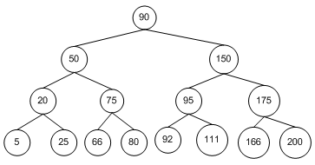
Searching and Inserting in BST
Suppose an ITEM is given
  Compare ITEM with the root node N of the tree
    If ITEM < N, proceed to the left child of N.
    If ITEM > N, proceed to the right child of N.
  Repeat step (a) until one of the following occurs:
    We meet a node such ITEM=N.
    We meet an empty subtree.

